Slide 1

Case Analysis: Maddison
Summative-Based Formative Assessment
Overview of issues and recommendations
BY: JHOMIE ROSE B. ANTES

Slide 2

Overarching Problem
Assessment is used mainly for grading rather than improving learning.

Slide 3
1. What is the overarching problem with the main character’s use of summative-based formative assessment?
The overarching problem is that the main character is misusing formative assessment by treating it like a summative assessment, which defeats its purpose of supporting learning. Instead of using formative assessment to give ongoing feedback and help students improve, she focuses on grading outputs in a final and rigid way. This results in students feeling pressured by scores rather than being guided by feedback for improvement. As a consequence, the assessment no longer supports learning development but instead functions as a performance measure, which reduces student engagement and limits meaningful learning growth.
Formative assessment should primarily be used to monitor learning progress, provide feedback, and adjust instruction, while summative assessment evaluates learning at the end of instruction. Mixing these without proper purpose weakens both processes.

Slide 4

Key Issues
- Focus on final scores
- Limited feedback
- No revision opportunities
- Assessment used to judge, not guide

Slide 5

Goal for Improvement
Shift from 'Assessment OF Learning' to 'Assessment FOR Learning'

Slide 6
2. How would you advise the main character to improve her summative-based formative assessment practice?
I would advise the main character to clearly separate the roles of formative and summative assessment and ensure that formative tasks are designed to support learning rather than merely produce grades. She should focus on giving timely, specific, and constructive feedback that helps students understand their strengths and areas for improvement instead of immediately assigning high-stakes scores.
She can also improve her practice by using formative assessment strategies such as self-assessment, peer feedback, reflective journals, and classroom discussions before final evaluations. In addition, she should use formative results to adjust her teaching strategies and provide remediation when needed. This approach ensures that students see assessment as part of learning rather than only as a grading tool.
By aligning formative assessment with learning goals and using it as a guide for improvement, she can create a more supportive and effective learning environment for students.

Slide 7

Recommendation 1: Feedback
Provide timely, specific feedback to guide student improvement

Slide 8
Recommendation 2: Revision
Allow drafts and revisions before final grading

Slide 9

Recommendation 3: Process-Based Assessment
Break tasks into stages:
Planning
Drafting
Reviewing
FINAL OUTPUT

Slide 10
Recommendation 4: Student Involvement
Use self-assessment and peer assessment to deepen learning

Slide 11
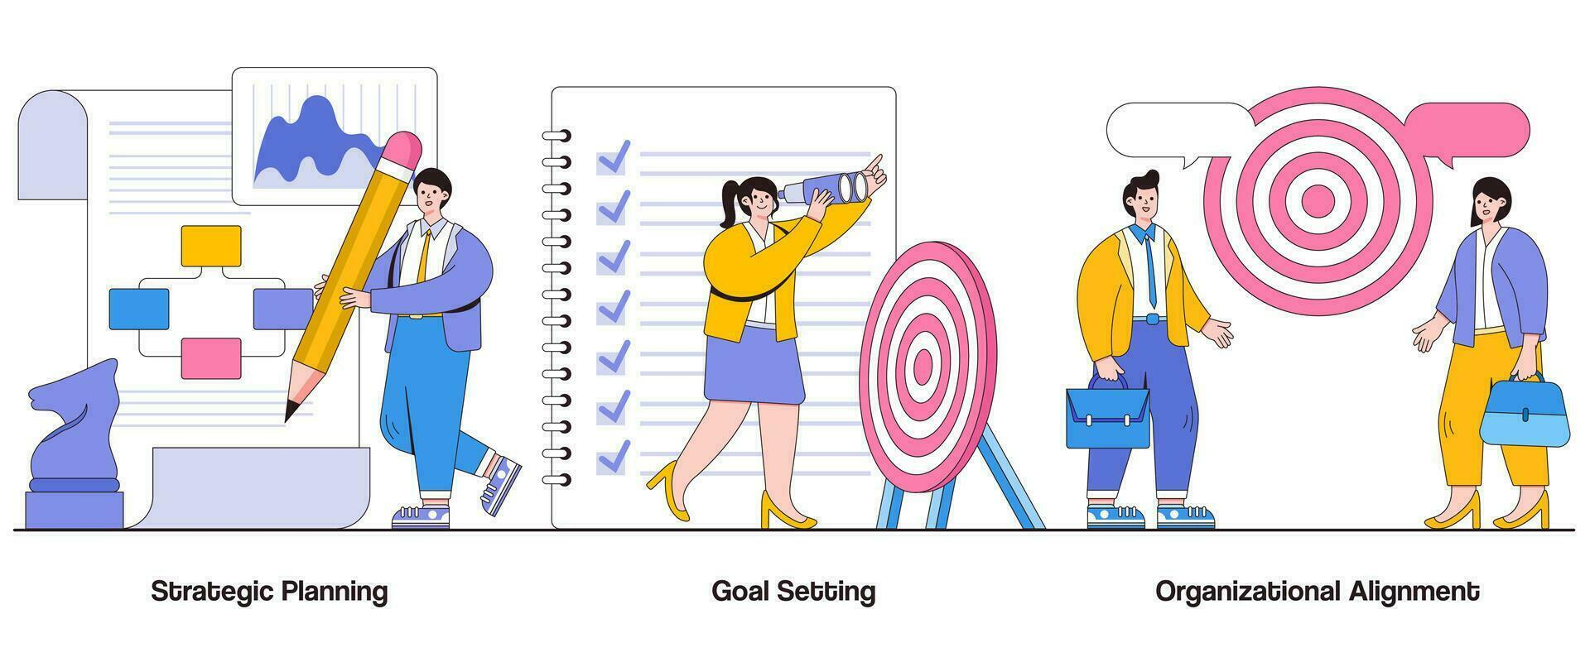
Recommendation 5: Alignment
Align assessments with learning goals and use clear rubrics

Slide 12
Conclusion
Effective assessment supports continuous learning, not just final performance

